Slide 1

eMes Functions and Reports
Airspeed VN 17/10/2024

Slide 2
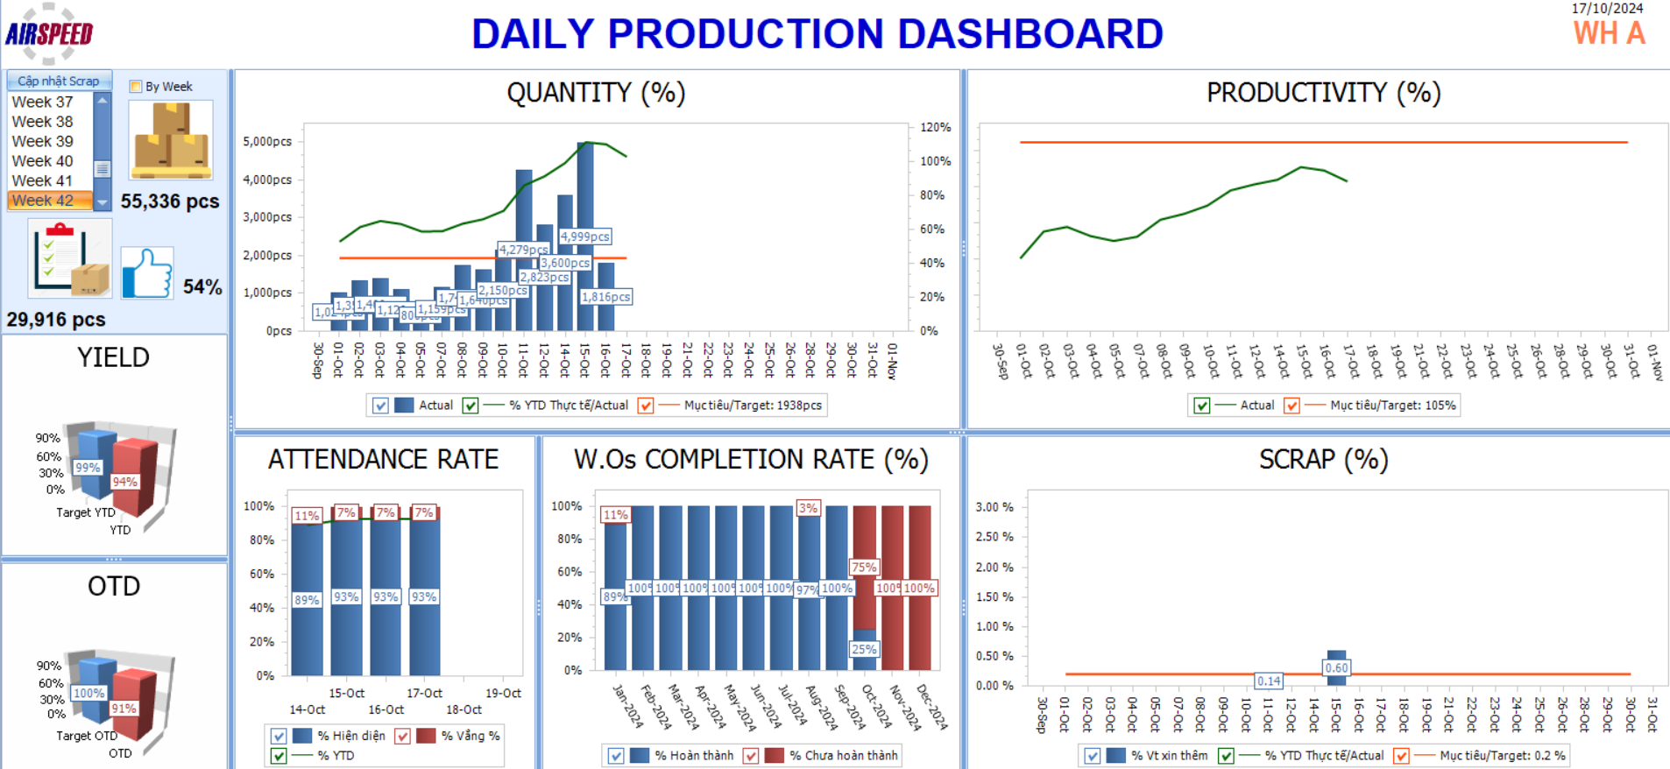
Dashboard report of each production line
WH A line is an example
Dashboard display for each line based on login user info.
Real-time data by week, month, and year.
Contains quantity, productivity, attendance, scrap, yield, otd, rate completion W.O charts.

Slide 3
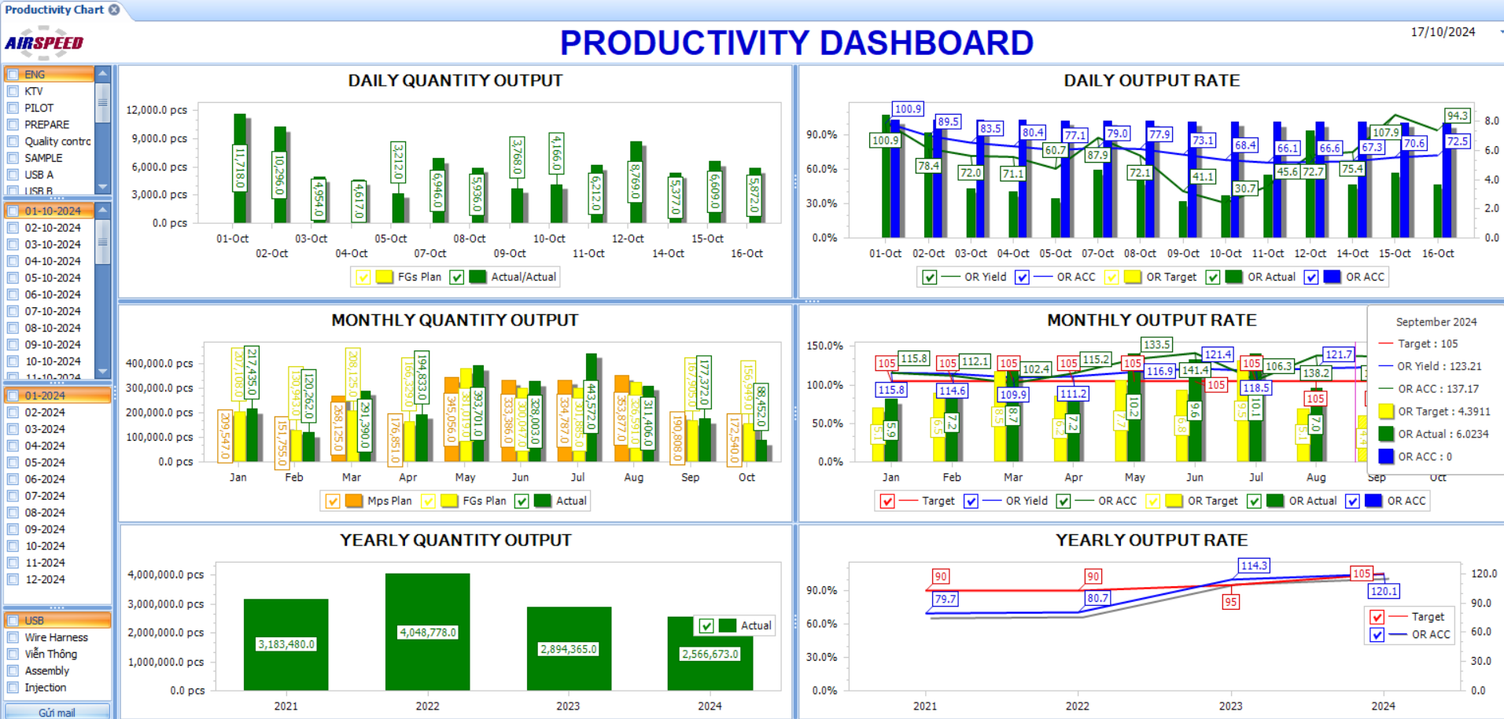
Dashboard report automatically sent via email daily

Slide 4
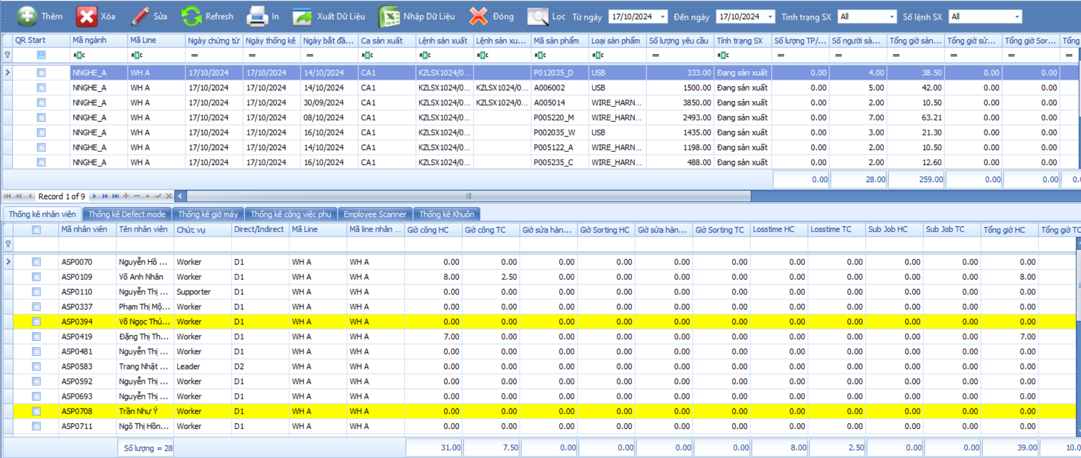
Production statistics
I. Employee working time: worktime, overtime, sub-job, loss time, rework time, sorting time.

Slide 5
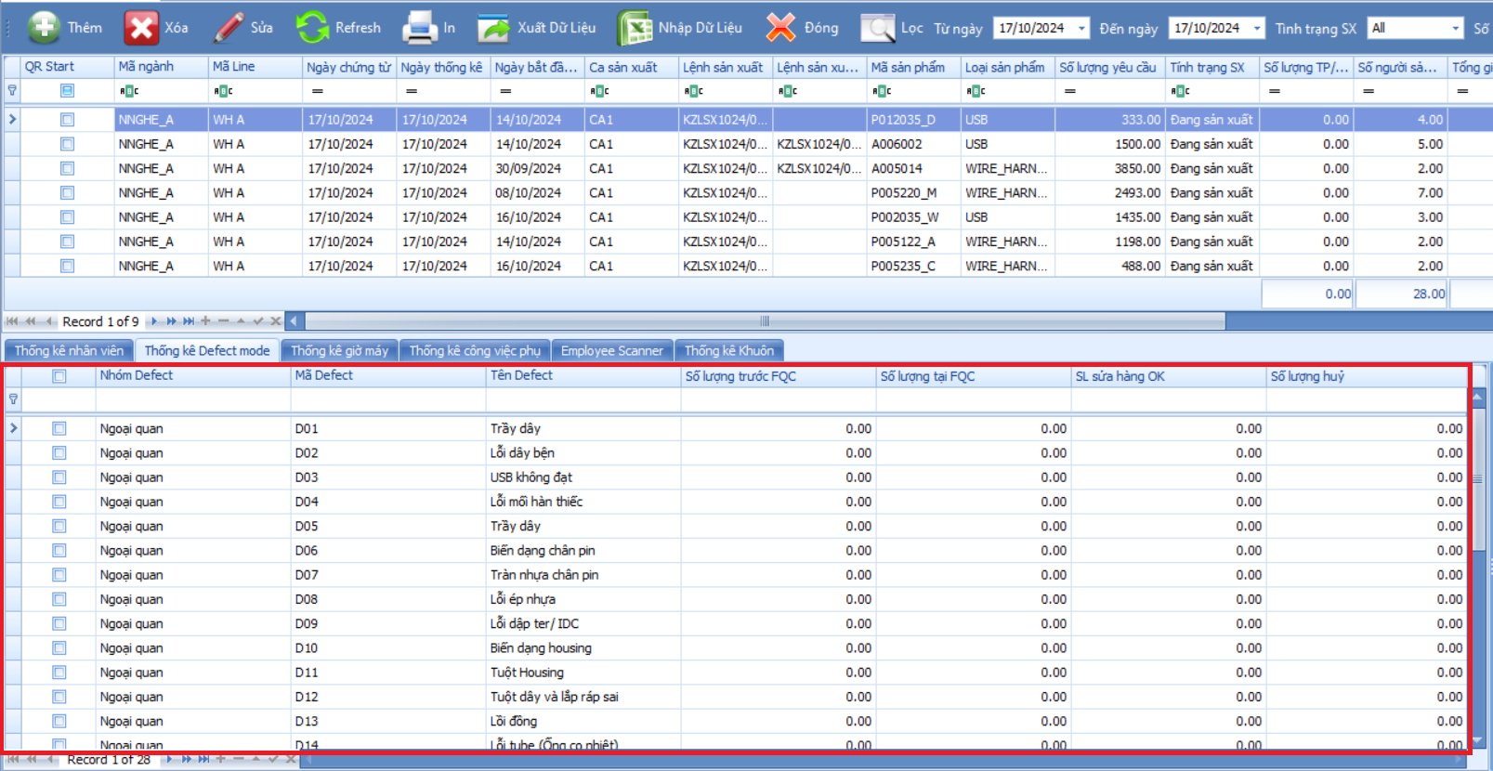
Production statistics
II. Defect: FQC quantity, previous FQC quantity, …

Slide 6
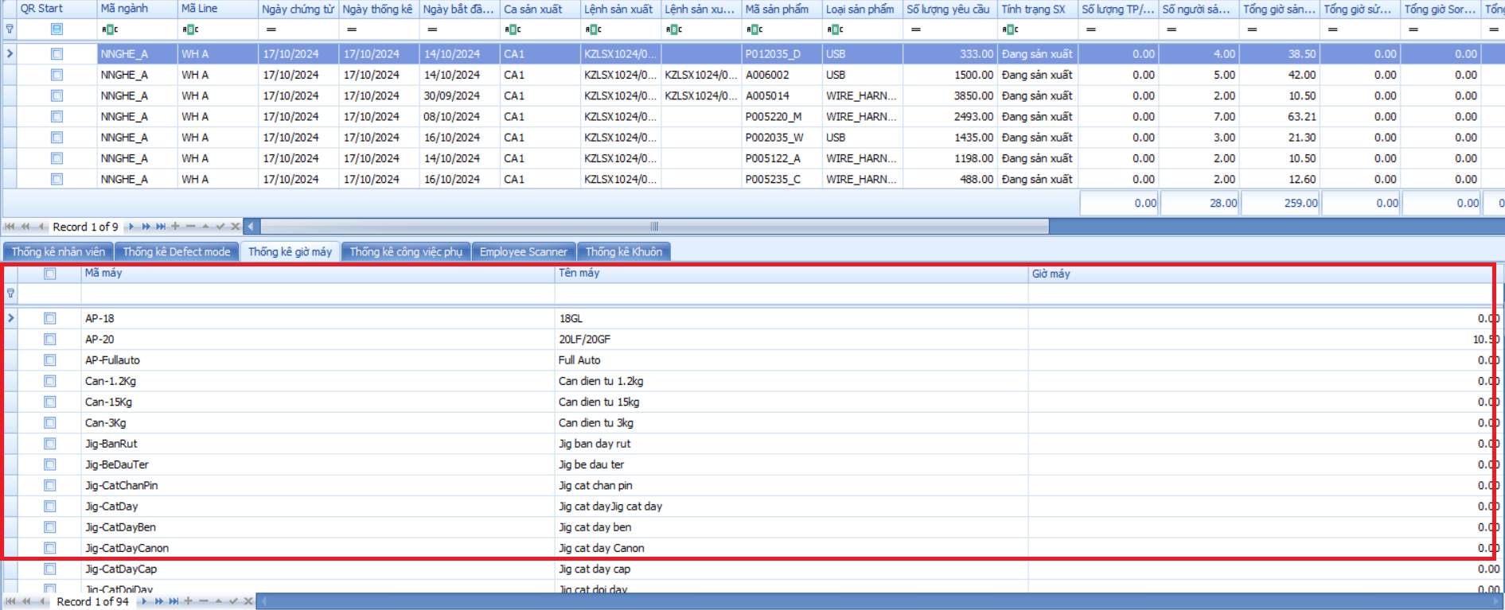
Production statistics
III. Machine time

Slide 7
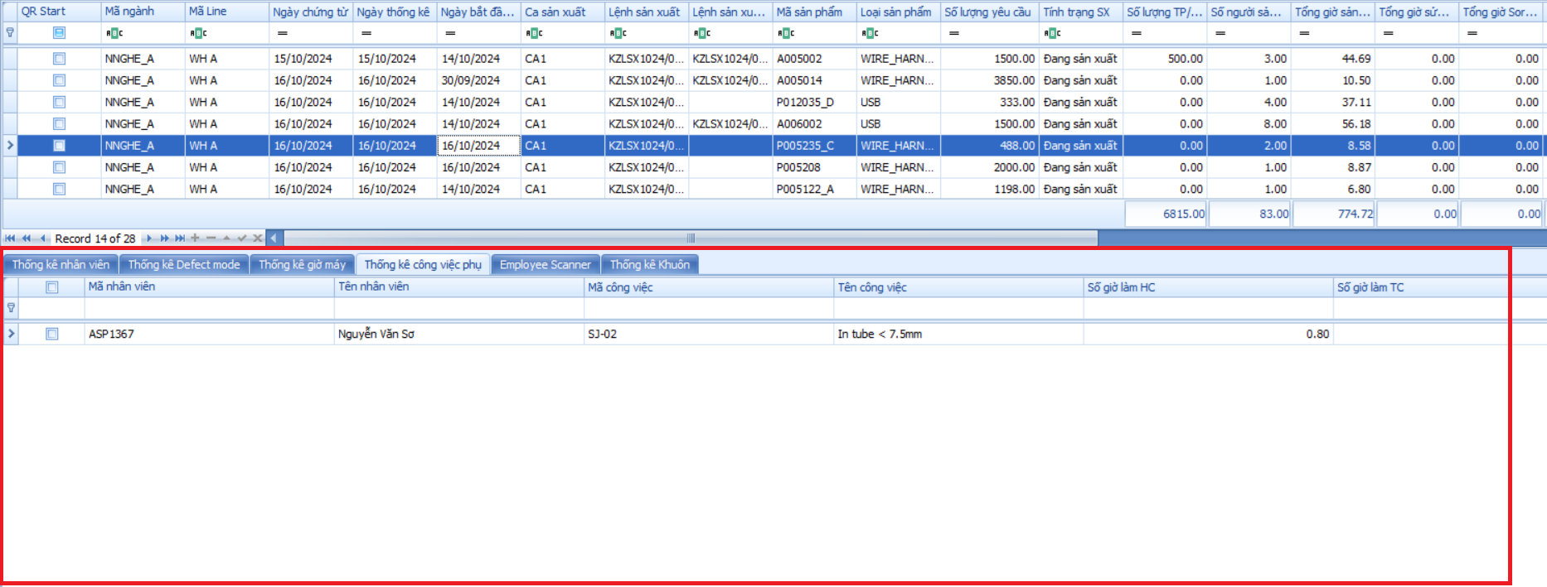
Production statistics
IV. Sub-job time

Slide 8
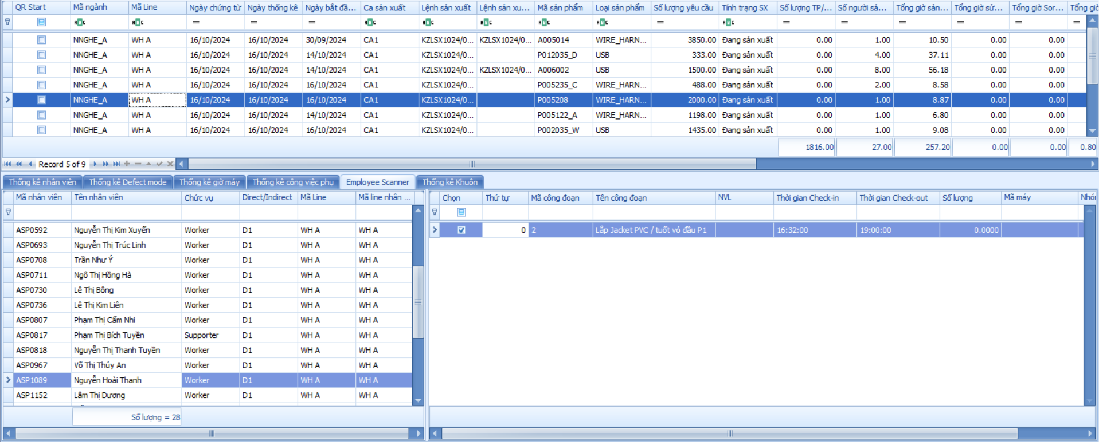
Production statistics
V. Scan QR Code Data: check-in time, and check-out time for each stage of W.O

Slide 9
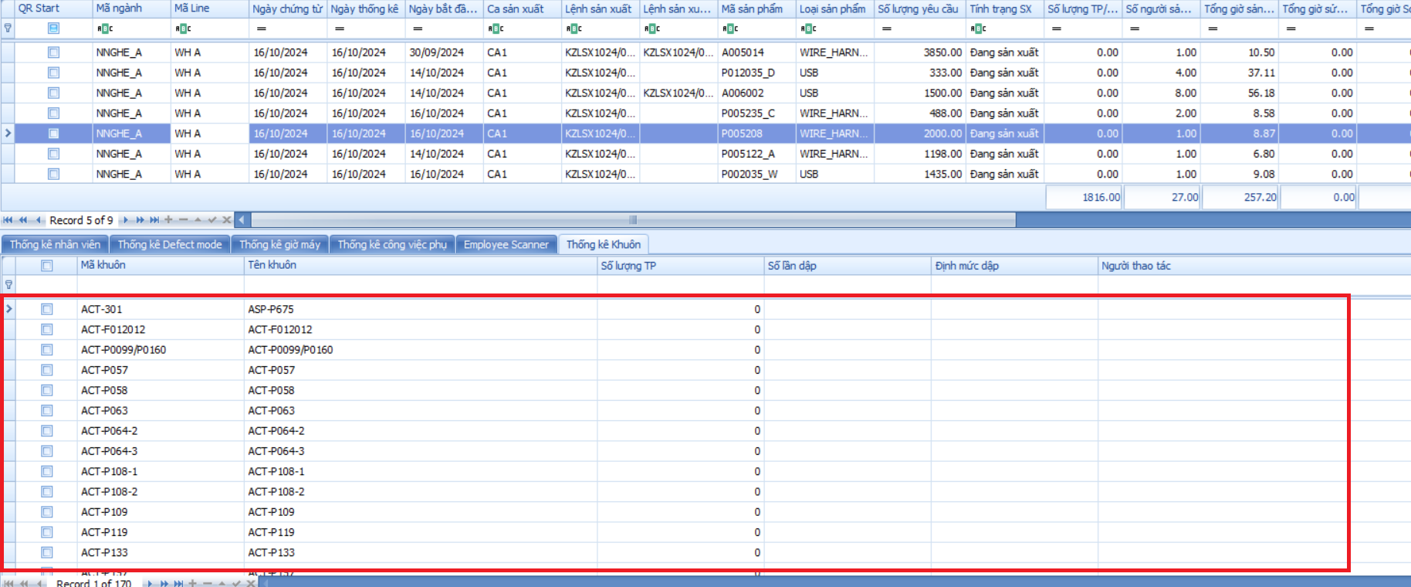
Production statistics
VI. Mold, Jig frequency statistic

Slide 10

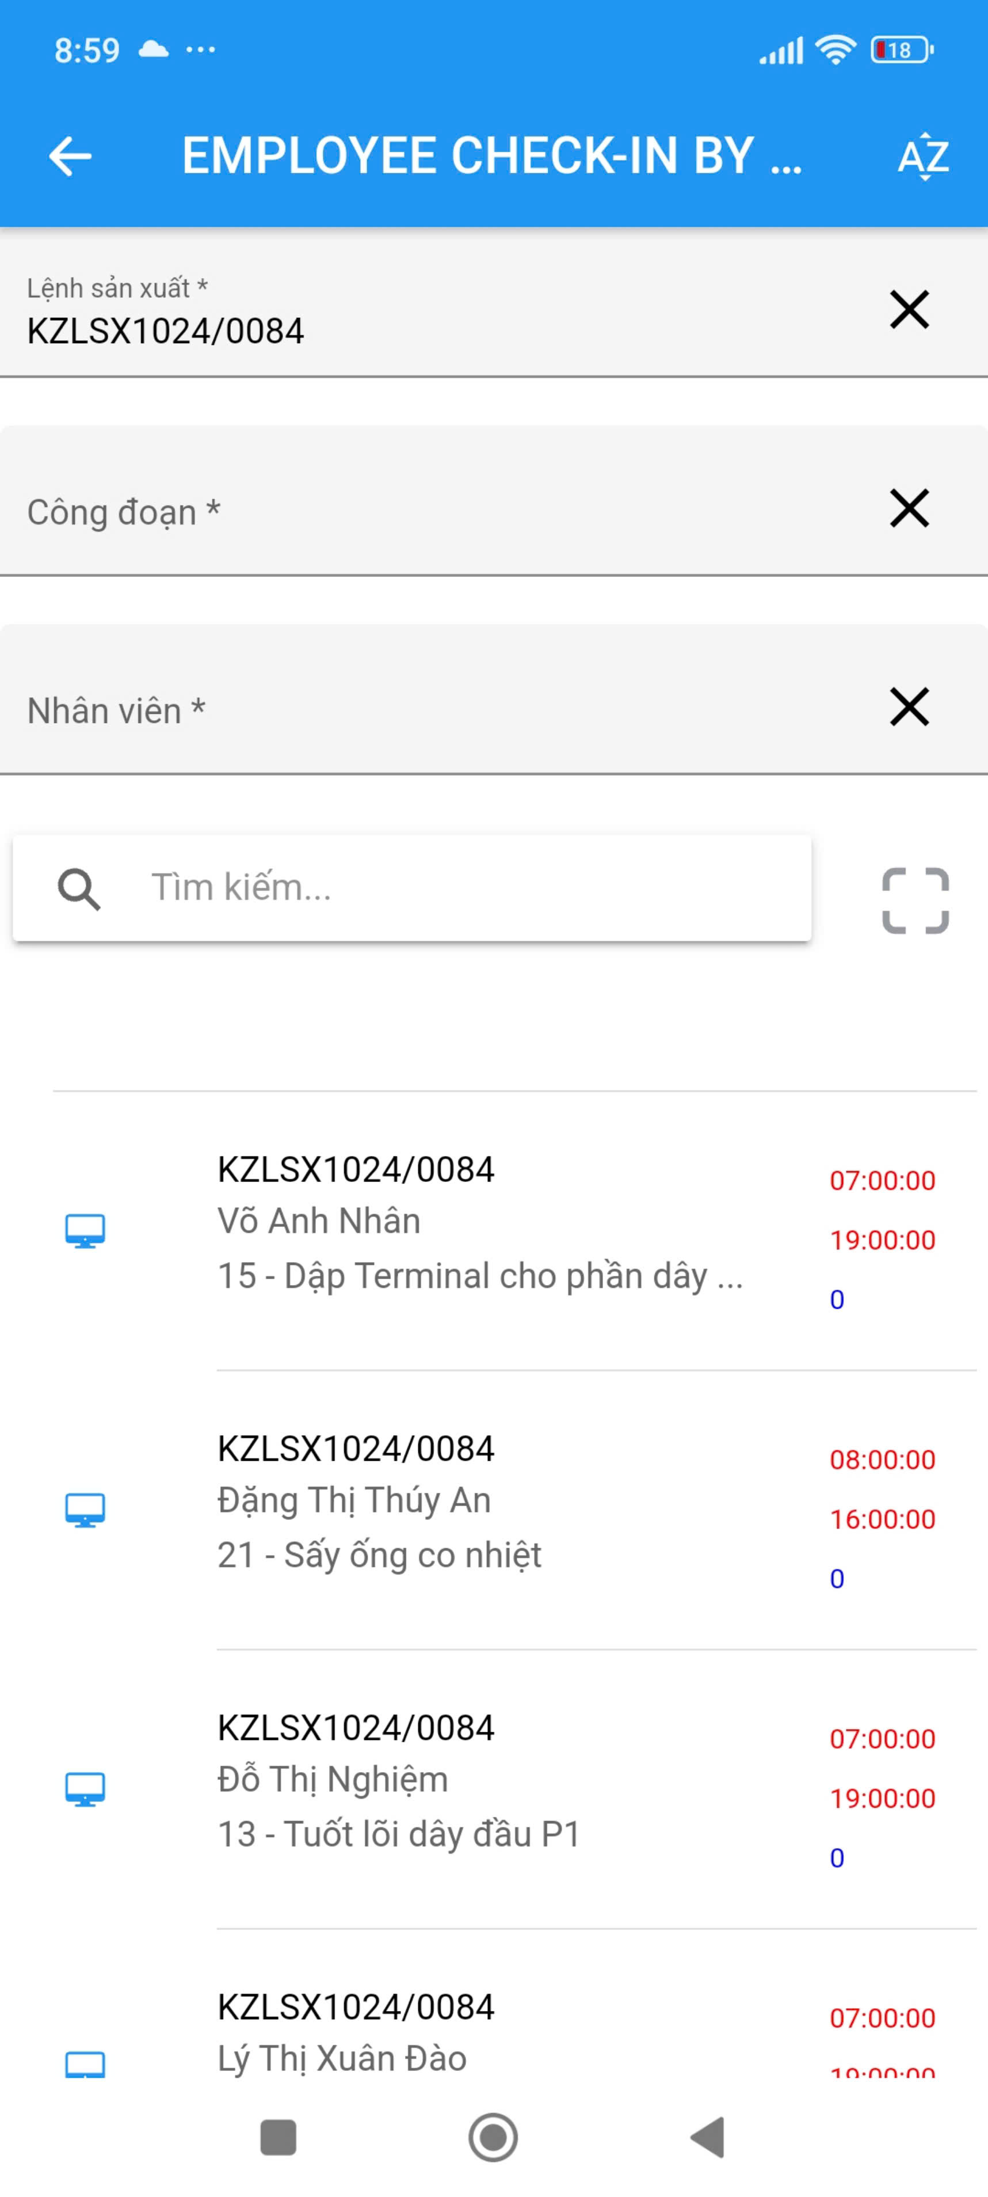
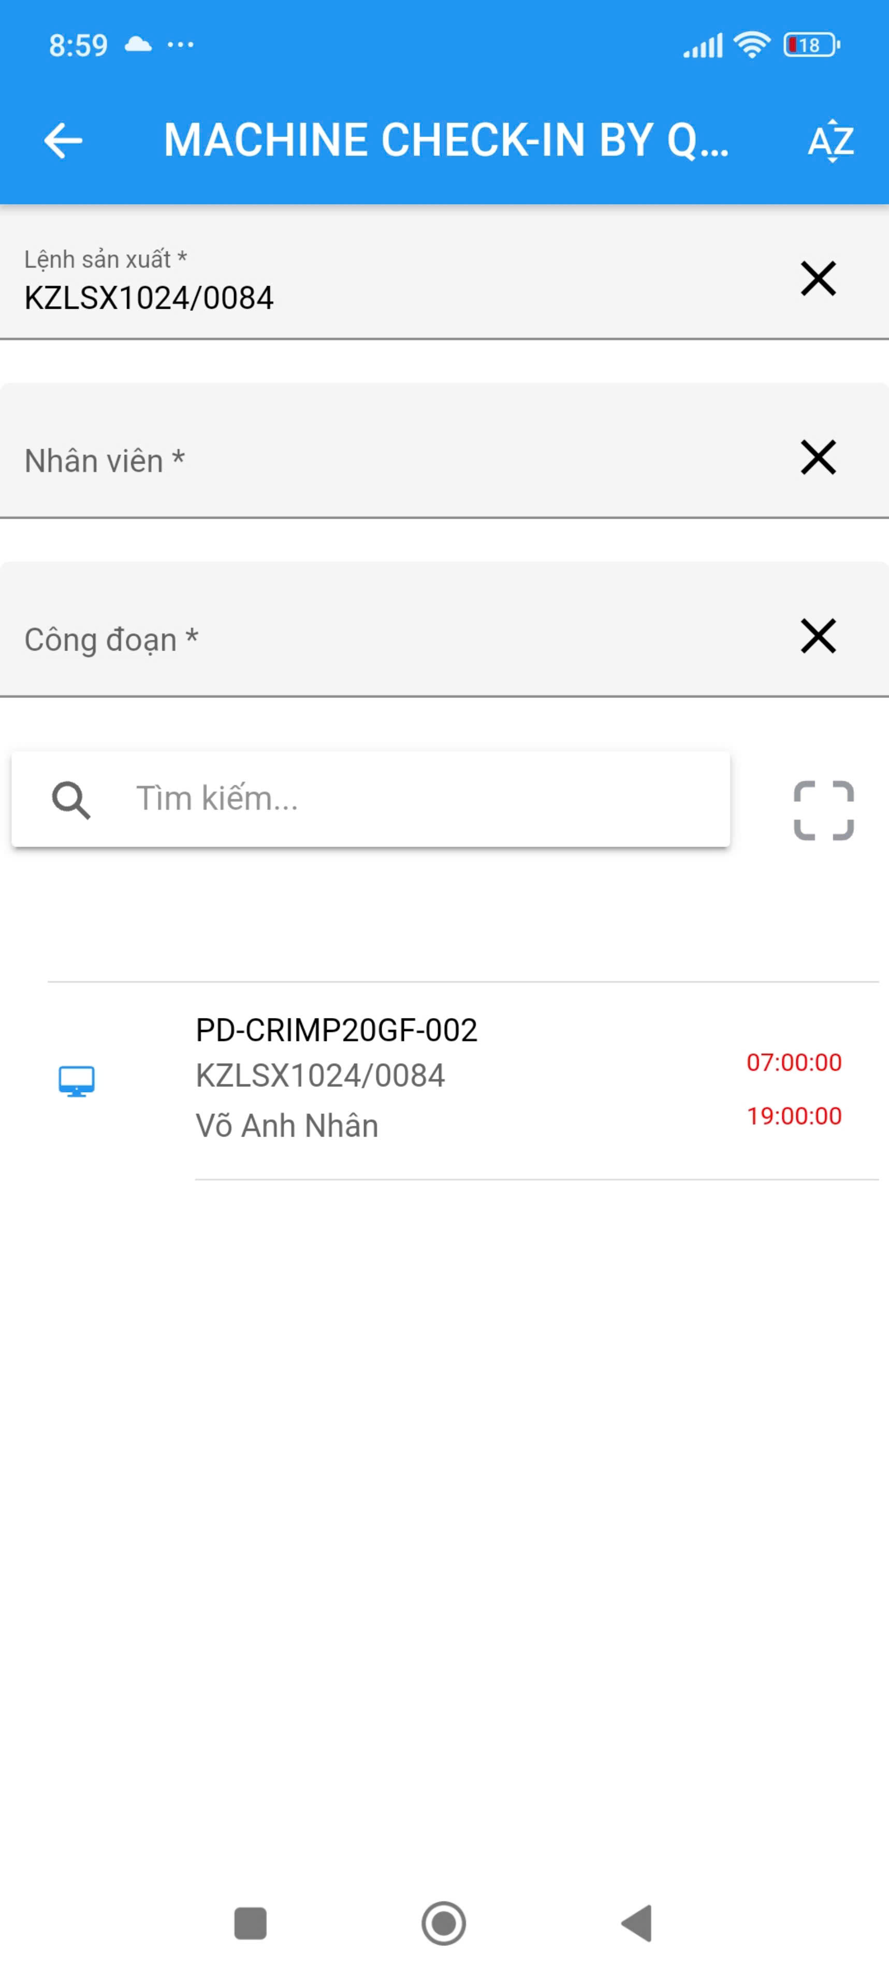
Production Scan QR Code App
Scan QR Code: employee worktime and machine time
Real-time saved into database
Run on Android devices such as tablets, mobile phones

Slide 11
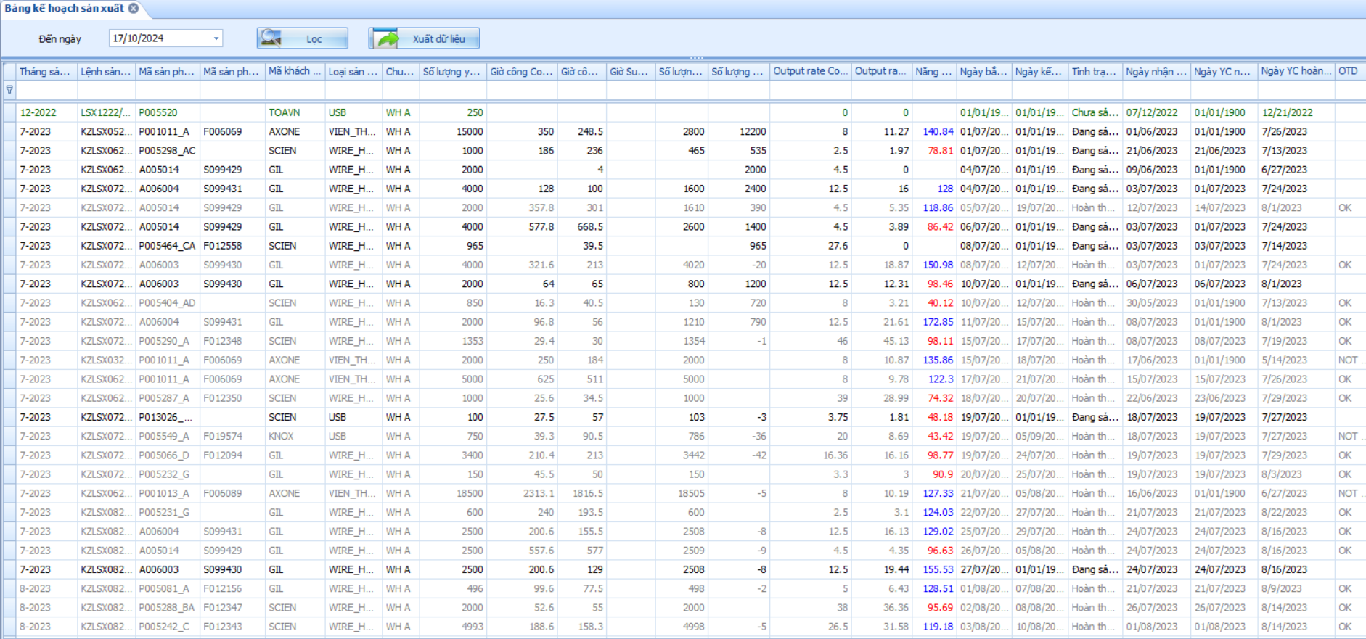
Production statistic reports
Production planning table

Slide 12
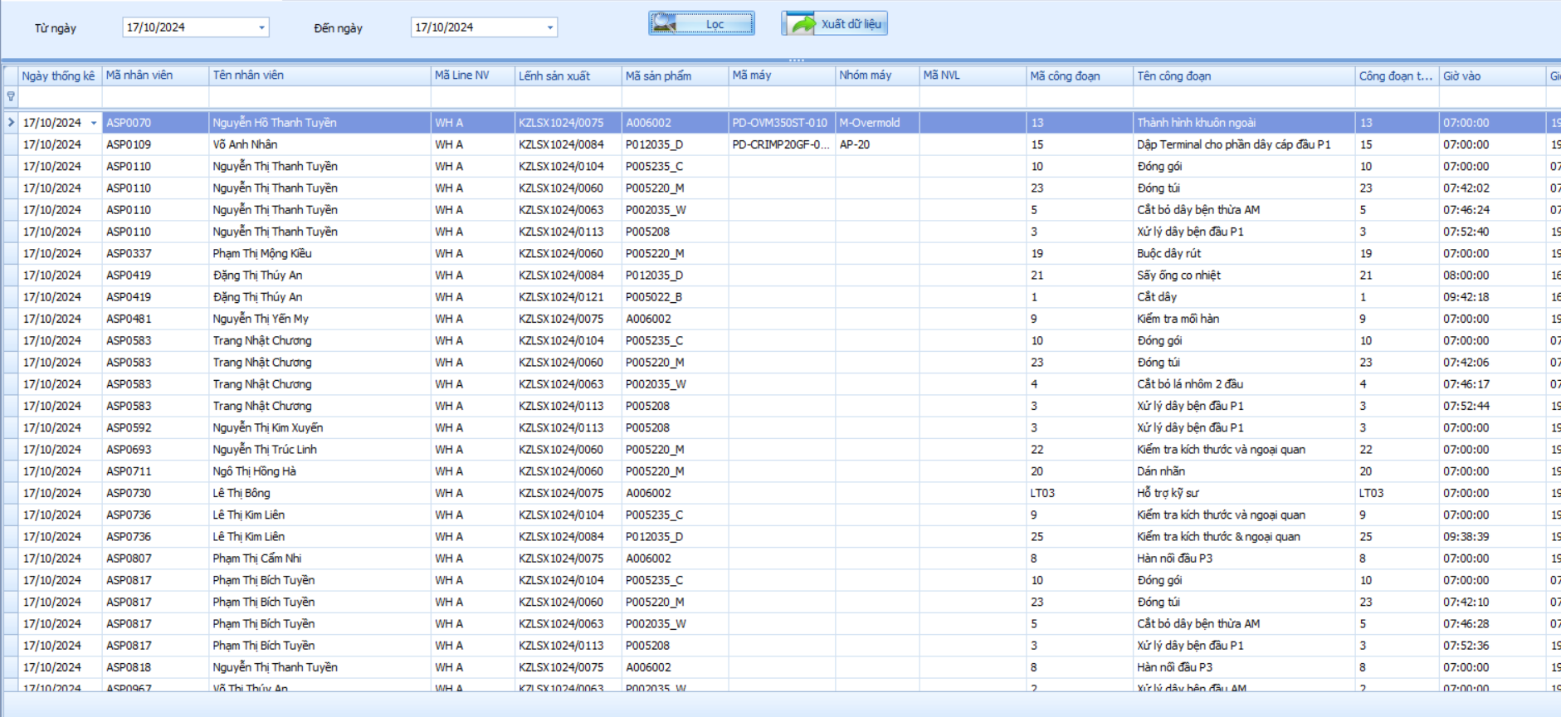
Production statistic reports
Detailed table of employee working hours by stage.

Slide 13
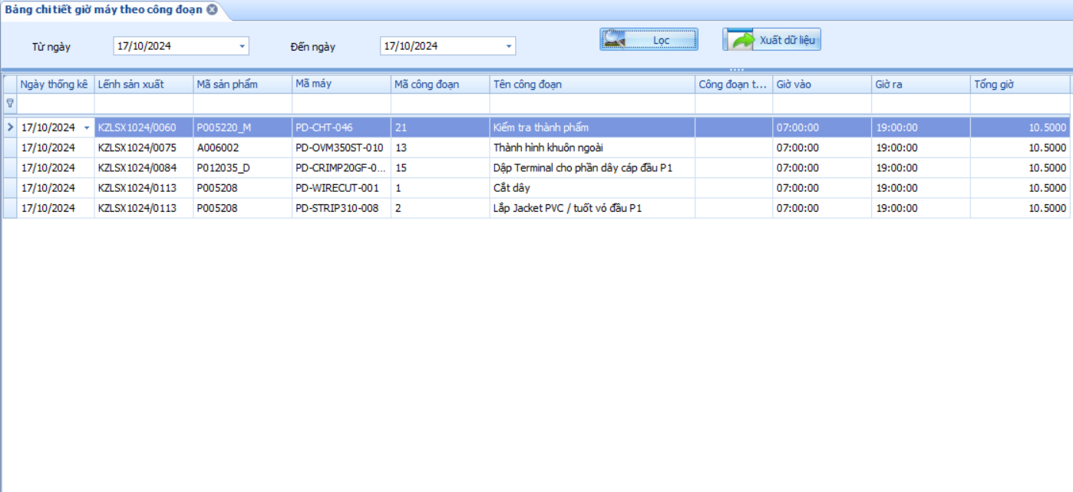
Production statistic reports
Detailed table of machine time by stage.

Slide 14
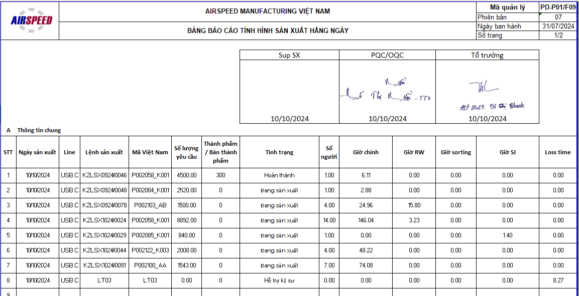
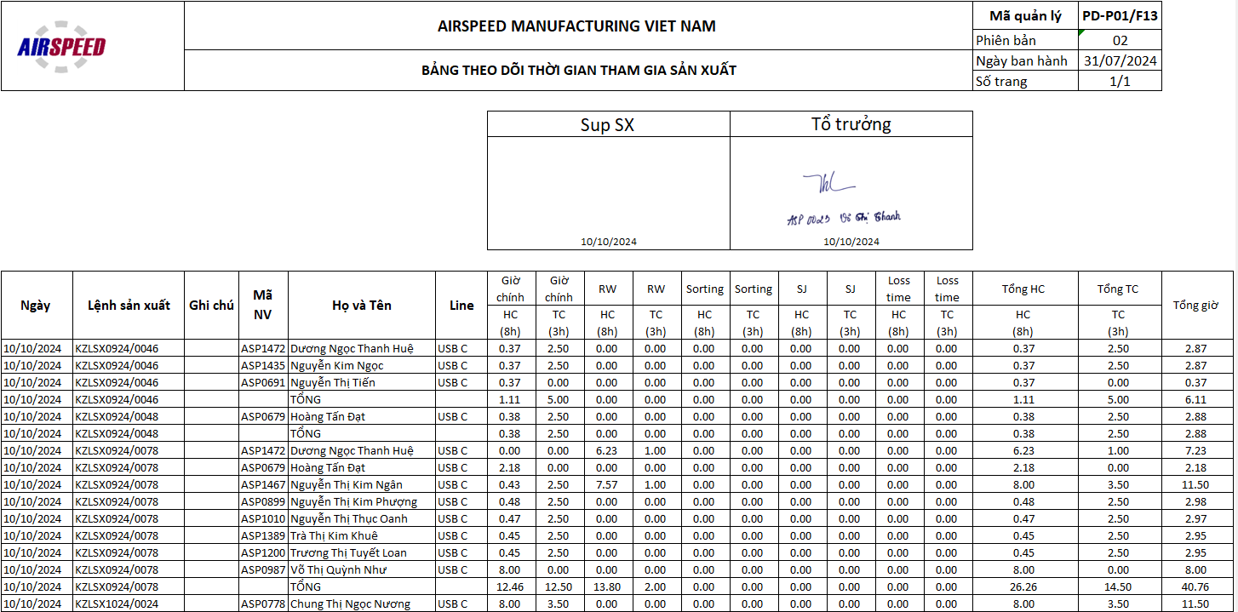
Production statistic reports
Detailed employee working time daily. (ISO standard)

Slide 15
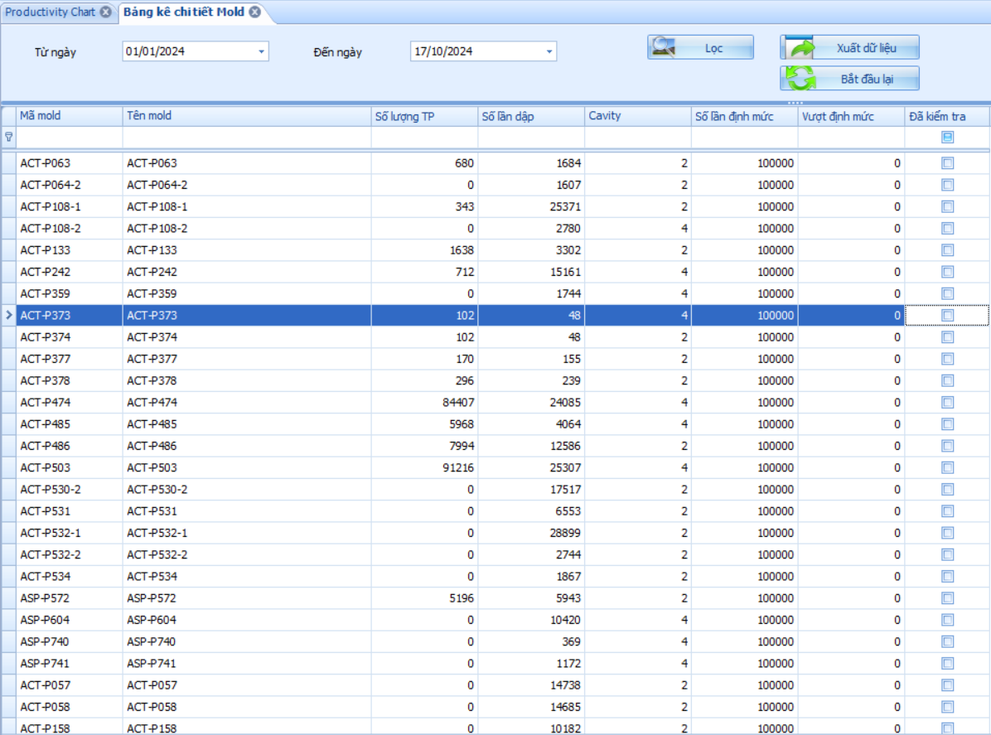
Production statistic reports
Detailed table of mold frequency.

Slide 16
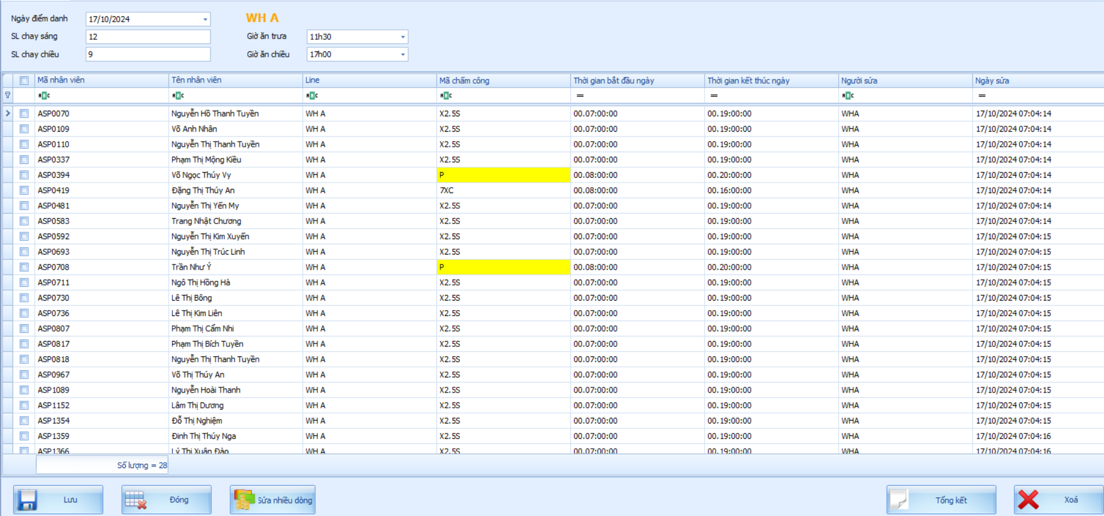
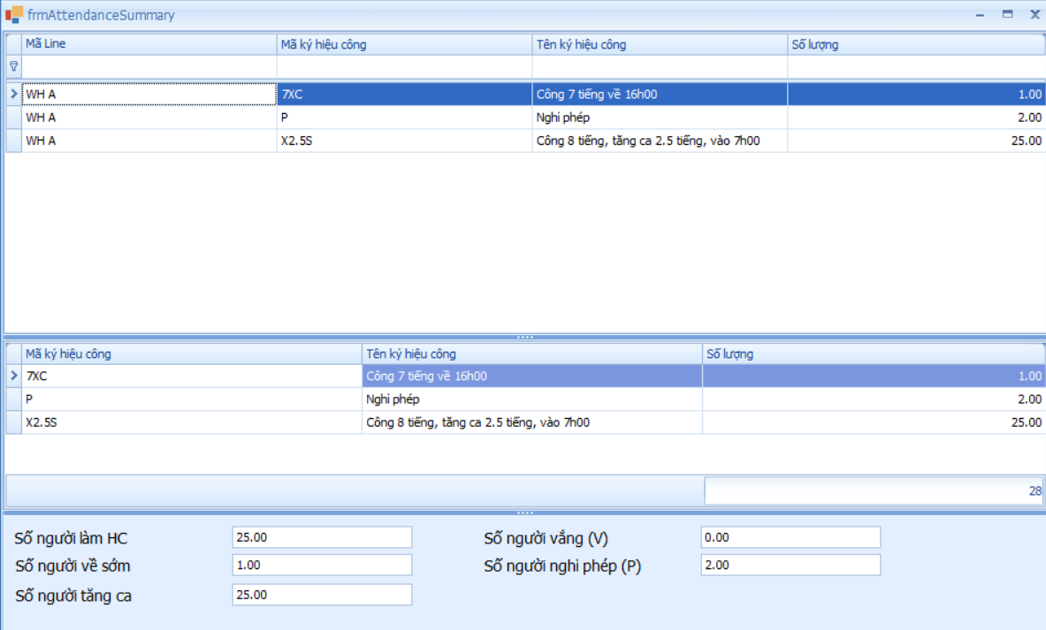
Production employee attendance
Based on timekeeping code.
To do the beginning of the working day.
Contains all employees of each line.

Slide 17
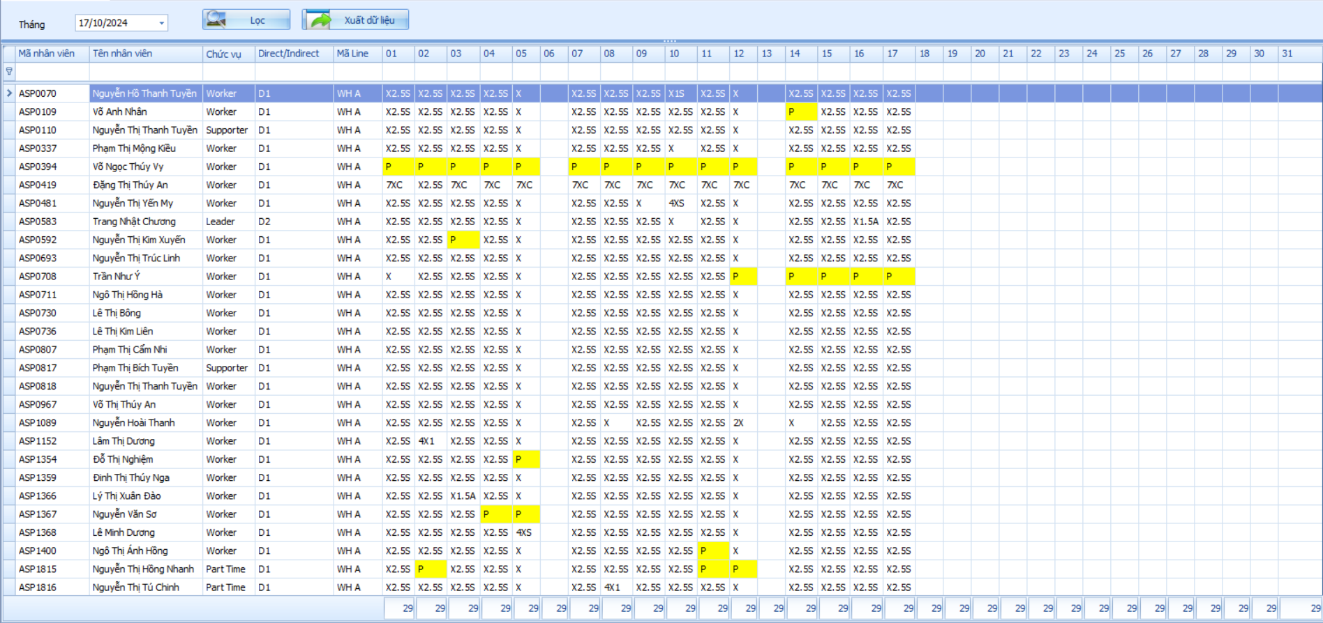
Production employee attendance
Employee attendance summary report

Slide 18
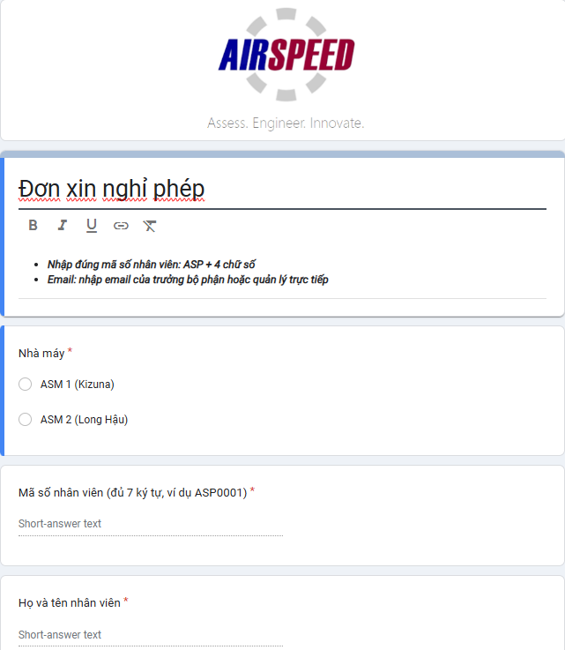
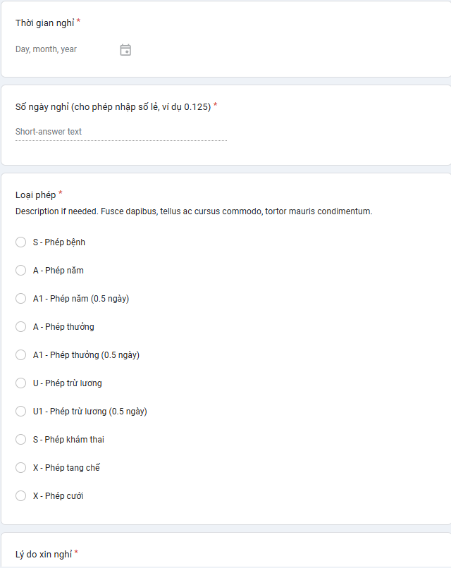
HR Online leave management
Online leave application

Slide 19
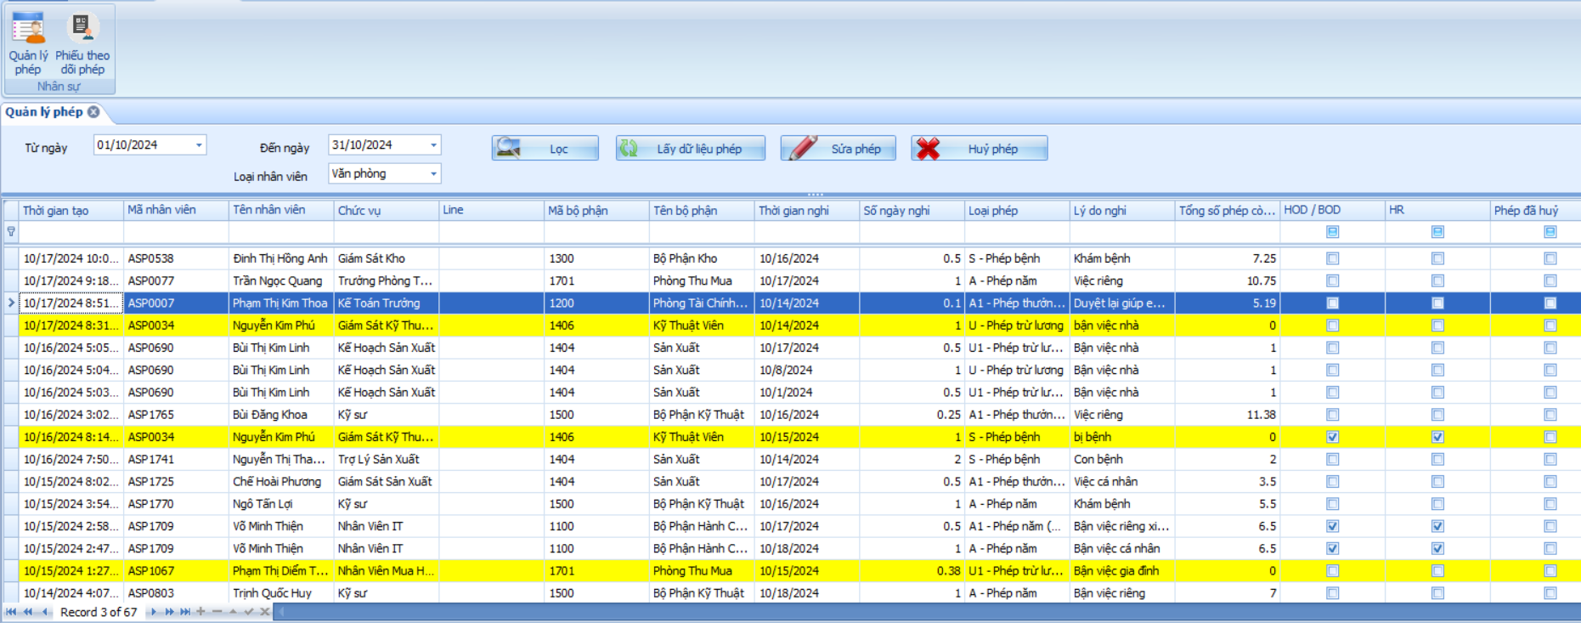
HR Online leave management
Leave management functions on eMes

Slide 20
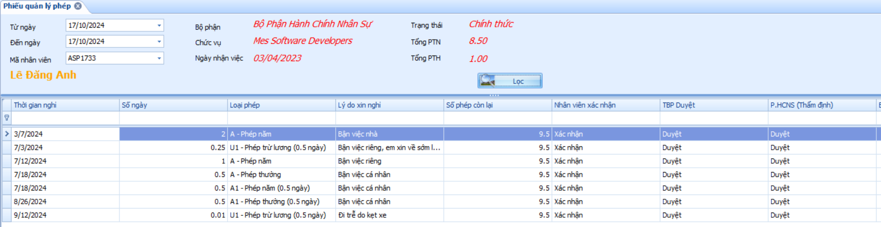
HR Online leave management
Leave tracking form

Slide 21
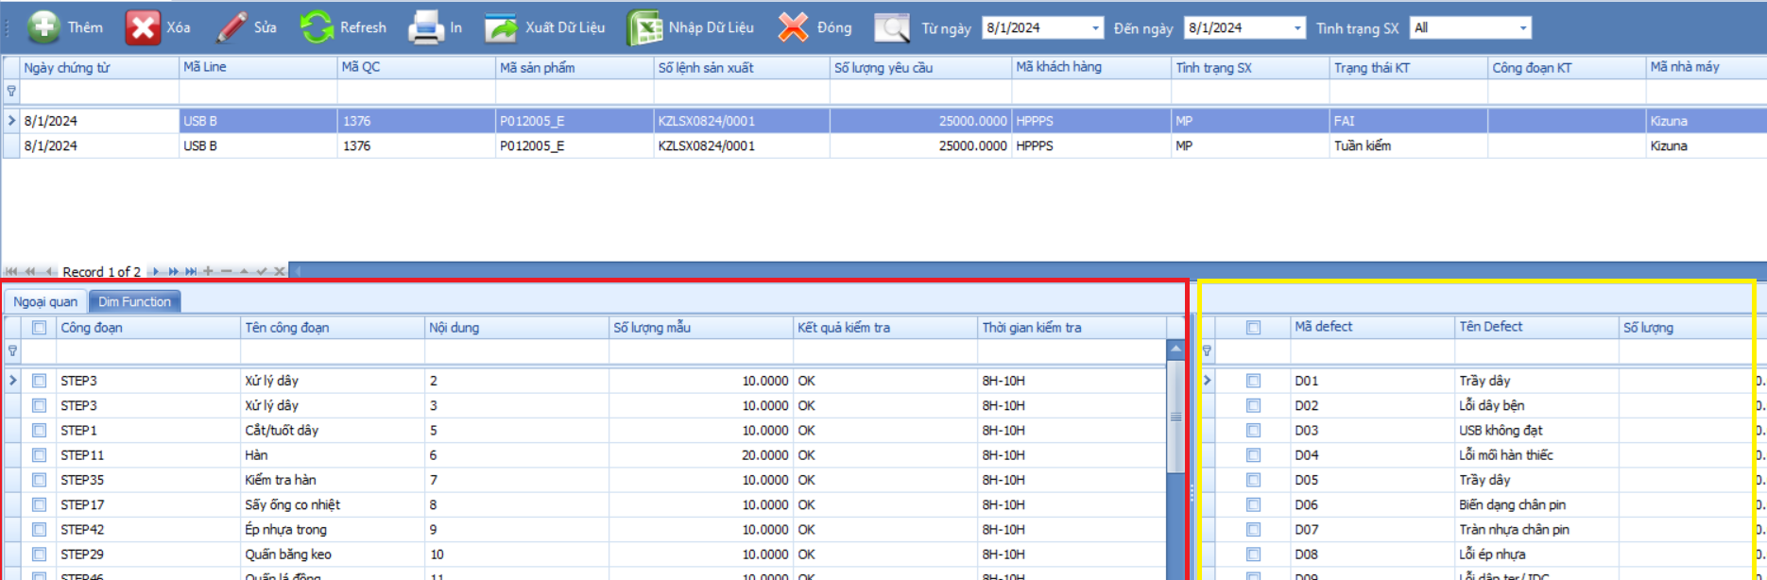
QA statistics
External Inspection:
By stage: template quantity, inspection result, inspection time
Defect: defect quantity on each stage

Slide 22
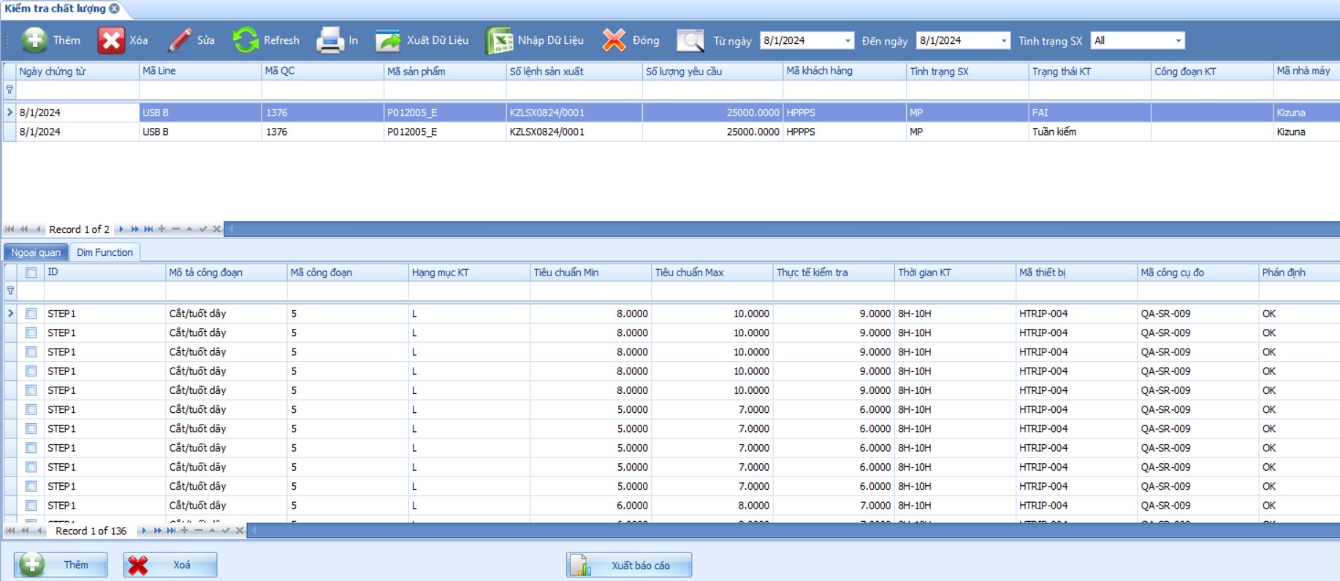
QA statistics
Dim function:
By stage: inspection list, min standard, max standard, real inspection, inspection time, measuring device, measuring tool
Defect: defect quantity on each stage

Slide 23
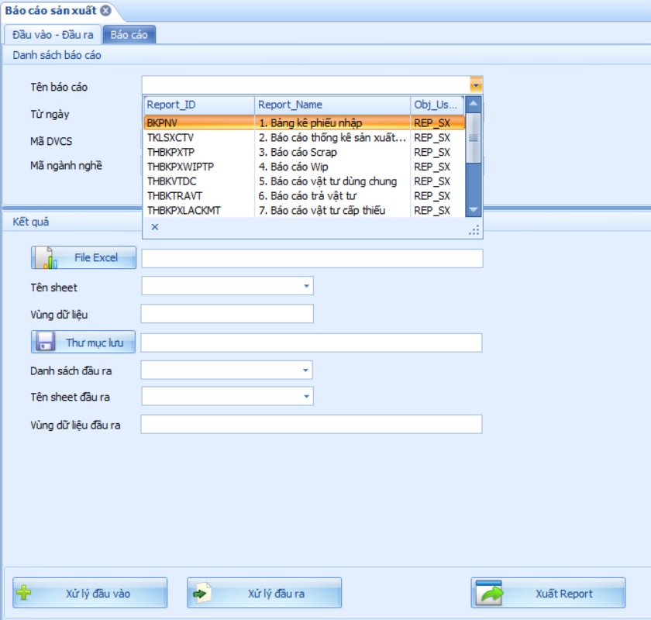
Report system to export excel
Contains:
Reports of production: scrap, wipe, attendance, ordering the meals…
Reports of planning: check full-kit material

Slide 24
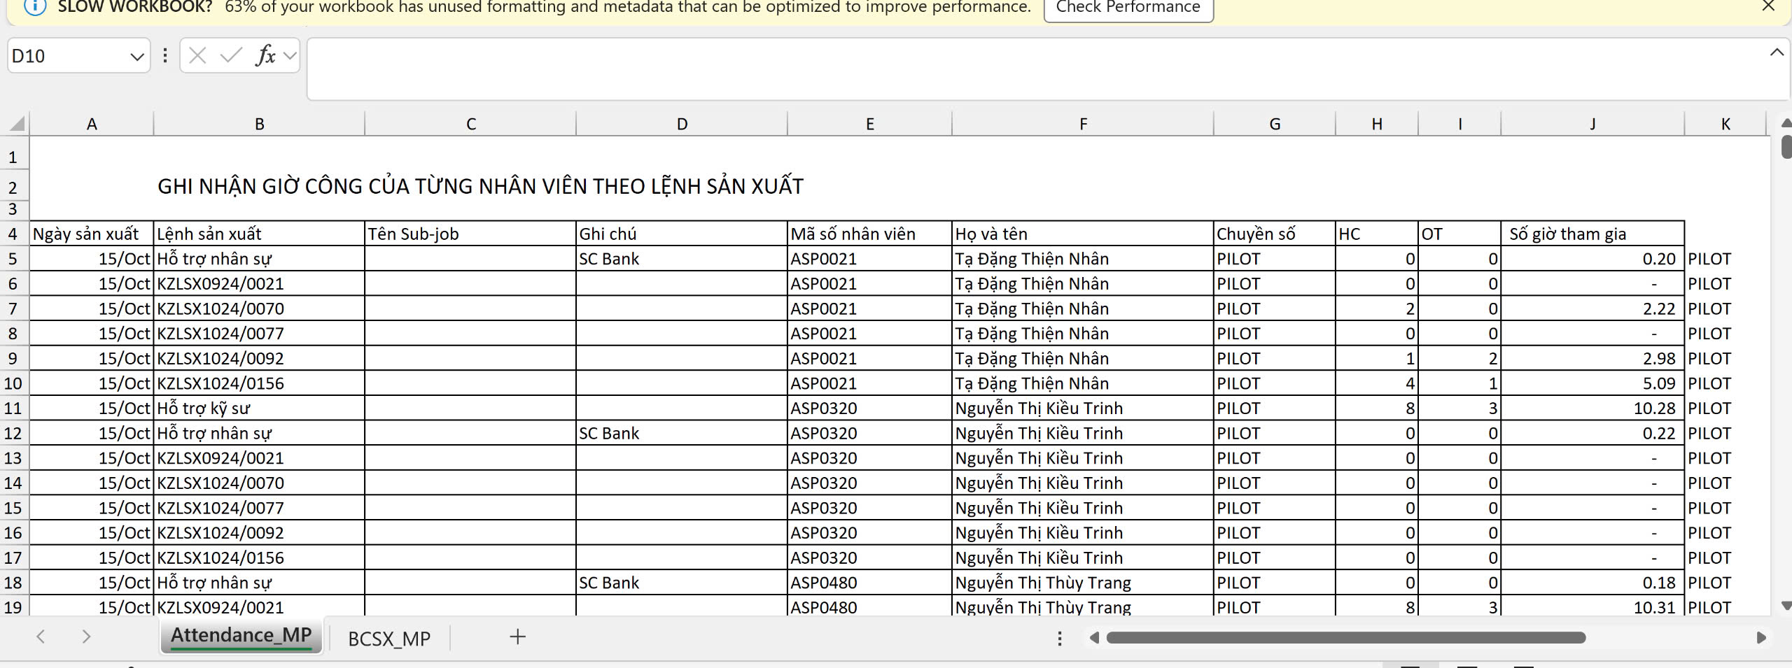
Report system to export excel
Some examples

Slide 25
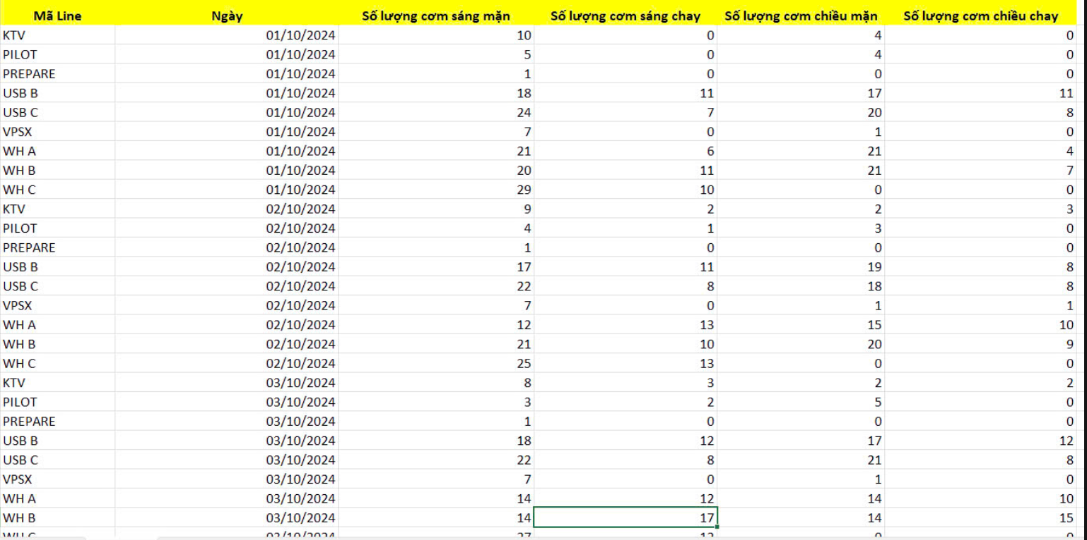
Report system to export excel
Some examples

Slide 26
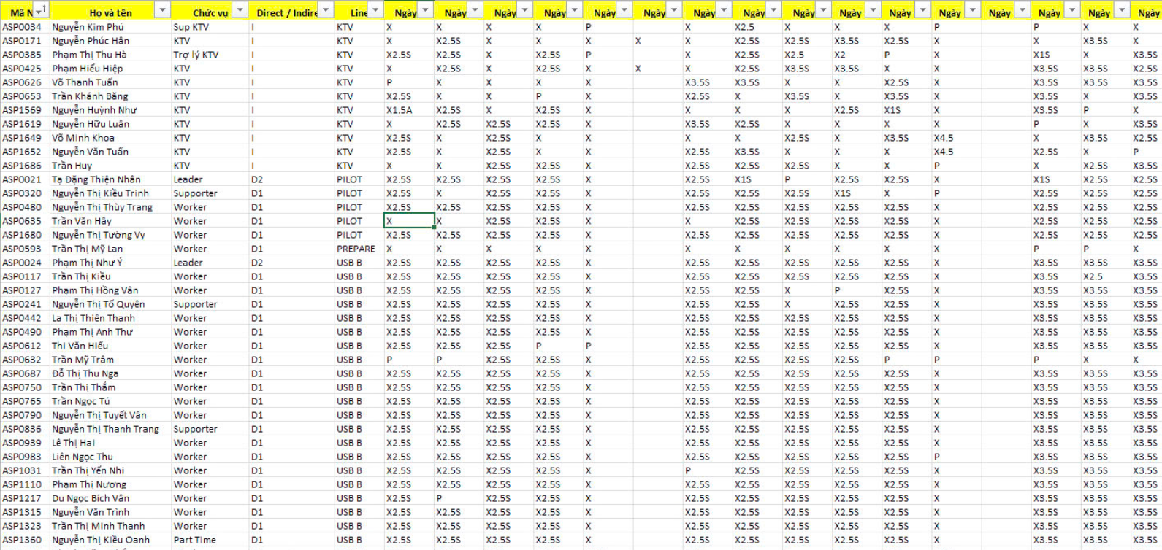
Report system to export excel
Some examples

